Slide 1
Jan Marek

Slide 2
presents

Slide 3
MY COUNTRY

Slide 4
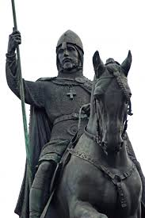
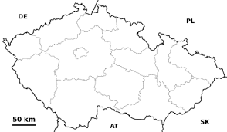
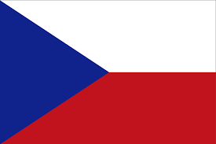
My country

Slide 5
Hello my name is Jan Marek and this my country
Czech Republic, capital city is Prague
Prague is biggest city Czech republic
In 2013, had approximately 1,247 000 residents

Slide 6
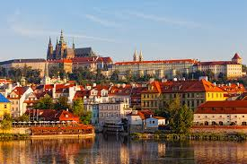
Capital Czech Republic: Prague
This foto

Slide 7
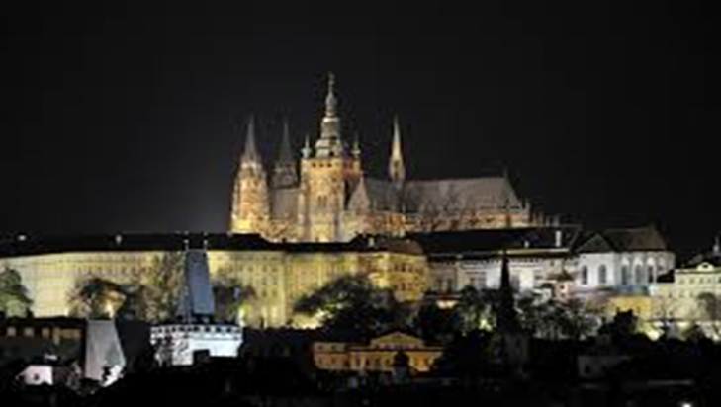
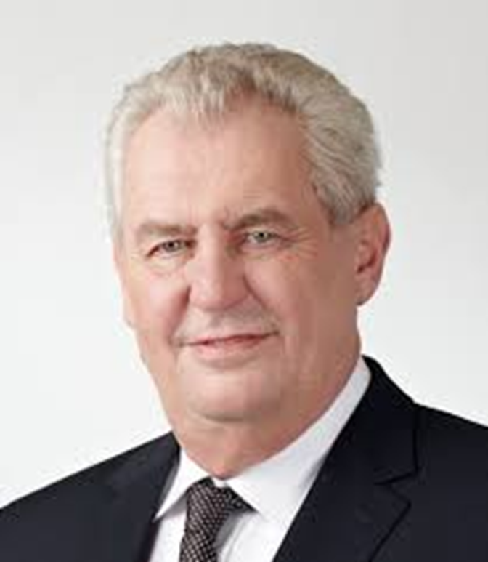
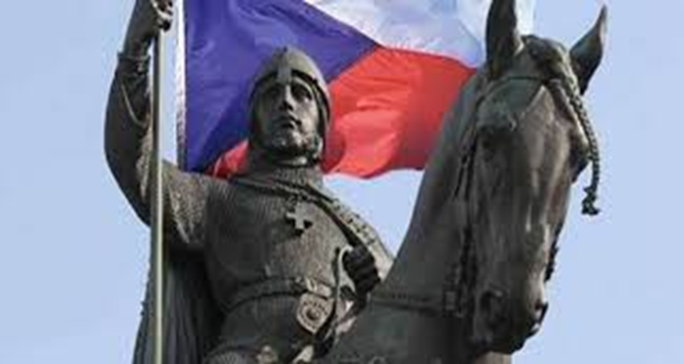
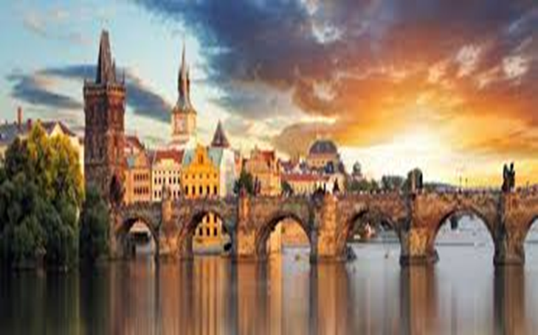
Points of Interest
In prague

Slide 8
Charles Bridge It was built by Charles IV. and in the 1402^{nd.} interest: According to the legend during the construction of the Charles Bridge he gave up gave him eggs.

Slide 9
statue of St. Wenceslas on the horse Among the most famous works of Czech and stand on Wenceslas Square.

Slide 10
Prague Castle at night It was founded in the 9th century and used to be the seat of rulers, kings, presidents today. . Note: president is Miloš Zeman

Slide 11
President
President Miloš Zeman
He was born on
September 28 in
Kolín and He was
elected president
in 2013.

Slide 12
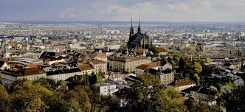
Brno
Brno is the second largest city in the Czech Republic.
2012 Brno had about 378,965 residents
This foto

Slide 13
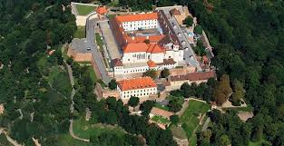
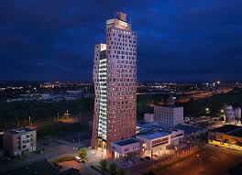
Sights in brno

Slide 14
Cathedral of St. Peter and Paul He began to build the 11th and 12th century Romanesque chapel and gradually perfecting.

Slide 15
Špilberk castle It was founded in the late 13th century and was built by Moravian Margrave (and later Czech king) Přemysl Otakar II.

Slide 16
az tower
It is the tallest building in the Czech Republic.

Slide 17
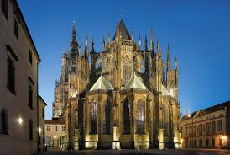
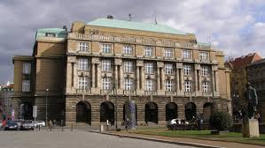
Histori my state
the most famous monarch Charles IV.
He has done for our nation so much built the Cathedral of St. Vitus Cathedral and Charles University and other things

Slide 18
Charles university in Prague

Slide 19
St. Vitus cathedral in Prague

Slide 20
THE END

Slide 21
RESOURCES
Music: OMFG HELLO AND CENTURIES .
Translation: Im ,Google translation and other persons.
Created in: Microsoft PowerPoint

Slide 22
Almost completed
Jan Marek
22.11.2016
I hope you enjoyed the presentation

Slide 23
tail-end
Listen to music
or
leave the presentation-click the Esc

