Slide 1
My county, city and school
CZ
Jakub Jan Liška

Slide 2
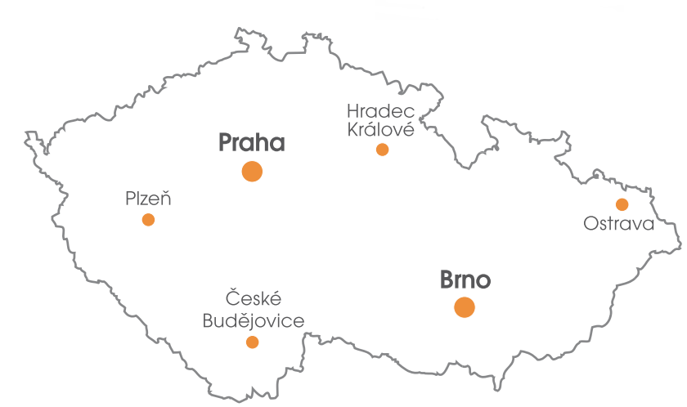
Map of Czech republic, Brno is the second largest city in the Czech Republic

Slide 3
Look Brno is beautiful

Slide 4
Brno has a nice Spilberk castle

Slide 5
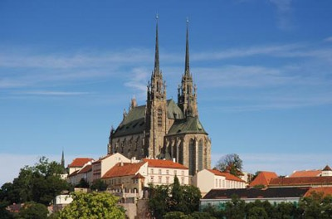
Petrov is the most famous and most beautiful church in Brno

Slide 6
This is our old town hall

Slide 7
Crocodile and the wheel are symbols of the city of Brno

Slide 8
Observatory in Brno

Slide 9
This is my school

Slide 10
This is our school playground

Slide 11
Another beautiful view of Brno

Slide 12
BYE

